Slide 2
This talk will follow the topical structure suggested by the ABP:
Copyright © 2019 by ASPHO

Slide 3
Vascular Anomalies
Basic Science and Pathophysiology – Major advancement for some disorders
Epidemiology and Risk Assessment – Need for Natural History Studies
Diagnosis
Management and Treatment
Denise M. Adams, MD
Boston Children’s Hospital
Copyright © 2019 by ASPHO

Slide 4
Classification of Vascular Anomalies The beginning of wisdom is calling things by their right names Chinese Proverb
Copyright © 2019 by ASPHO

Slide 5
Vascular Anomalies
Mulliken & Glowacki. Plast Recon Surg 1982
Tumors
Malformations
Low Flow
High Flow
Copyright © 2019 by ASPHO

Slide 6
ISSVA Classification – 2014 ( Wassaf et al Pediatrics Vol 136 Number 1, July 2015)
http://www.issva.org/classification; This work is licensed under a
Creative Commons Attribution 4.0 International License.
Copyright © 2019 by ASPHO
Notes:
Just last month in Melbourne, Australia, a new classification was adopted.
This has now been expanded to include many newer diagnoses, anatomical variants, and named syndromes.
As well as known/accepted genetic causes.
But note that the main differential remains between tumors (things that grow) and malformations (present since birth, grow with child).

Slide 7
Vascular Tumors
Copyright © 2019 by ASPHO

Slide 8
Category | Vascular Tumor Type
Benign | Infantile hemangioma/hemangioma of infancy
 | Congenital hemangioma
 | —Rapidly involuting (RICH)
 | —Non-involuting (NICH)
 | —Partially y Involuting (PICH)
 | Tufted angioma
 | Spindle cell hemangioma
 | Pyogenic granuloma (also known as lobular capillary hemangioma)
 | Others
Locally aggressive or borderline | Kaposiform hemangioendothelioma
 | Retiform hemangioendothelioma
 | Papillary intralymphatic angioendothelioma (PILA), Dabska tumor
 | Composite hemangioendothelioma
 | Kaposi sarcoma
 | Others
Malignant | Epithelioid hemangioendothelioma
 | Angiosarcoma
 | Others
Copyright © 2019 by ASPHO

Slide 9
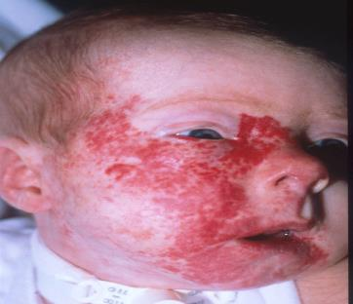
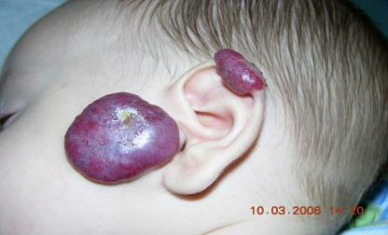
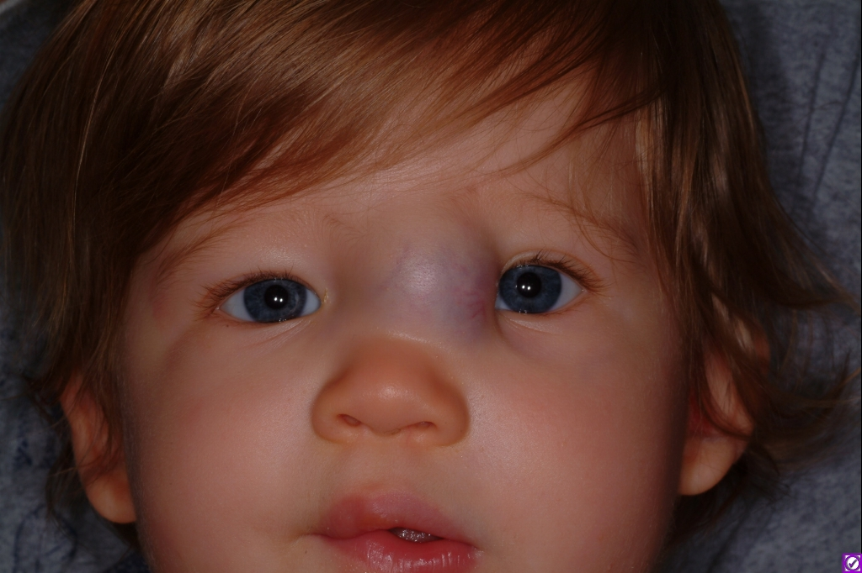
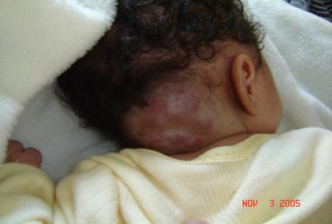
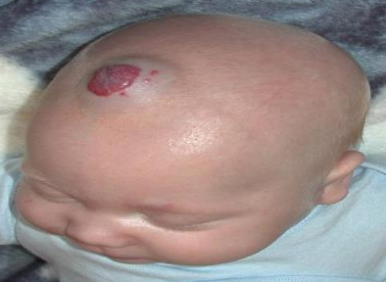
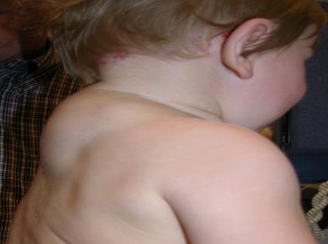
Hemangioma
Copyright © 2019 by ASPHO
Notes:
The main types of hemangiomas include superficial lesions, deeper hemangiomas that have a bluish hue and often have superficial telangiectatic vessels and a combination of both types

Slide 10
Hemangioma Epidemiology
Most common tumor of childhood: estimated prevalence 4-5% in Caucasian infants.
Limited epidemiologic data
60% are in the H&N
F>M
Highly variable appearance
Estimated that 12% or 10,000 infants/year require systemic therapy
Proliferate for 5 months
Involution by 3.5 years
Hemangioma Investigator Group
( HIG) http://hemangiomaeducation.org
Copyright © 2019 by ASPHO

Slide 11
Copyright © 2019 by ASPHO

Slide 12
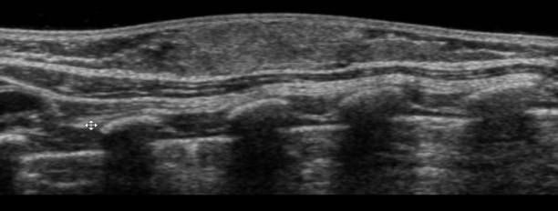
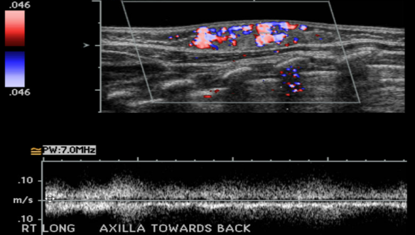
Infantile Hemangioma (IH)
Well defined mass
High flow vessel during proliferative phase with low resistive arterial flow
Decreased size with fatty replacement during involuting phase
Copyright © 2019 by ASPHO

Slide 13
Infantile Hemangioma
H&E
GLUT-1: Positive
Glut-1
Copyright © 2019 by ASPHO
Notes:
3 histological growth phases: proliferating till about 2 year or so, involuting, involuted phases similar to skin lesions
Capillaries lined by plump endothelial cells – rare mitosis; do not typically see hemorrhage or necrosis.
GLUT-1 - glucose transporter member 1 (SLC2A1) is a protein that in humans is encoded by the SLC2A1 gene.[1] GLUT1 facilitates the transport of glucose across the plasma membranes of mammals.[2] Positive in RBCs, endothelial cells in the blood brain barrier (meninges)
Low power demonstrates a vascular lesion composed of back to back capillaries arranged in lobules with minimal intervening stroma within the superficial and deep dermis. Higher magnification demonstrated thin capillary basement membrane, and plump endothelial cells, Glut-1, is positive. The histological findings are consistent with Infantile hemangioma, superficial and deep, proliferating type.
Differences: arise in dermis but extend to subcutis while deep-seated PGs are only in subcutis; as it involutes, basement membrane thickens. IHC aside from glut-1 shows Lewis Y, merosin, and CD15 positivity (PG is not)
Glut-1 (an erythrocyte glucose transporter protein normally highly expressed at blood-tissue barriers, )

Slide 14
Associated Syndromes
Copyright © 2019 by ASPHO

Slide 15
Copyright © 2019 by ASPHO

Slide 16
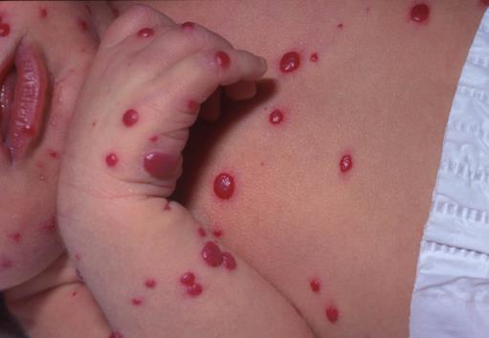
Multiple Cutaneous Hemangiomas
Associated with internal hemangiomas
Most commonly in the liver
Other areas include: CNS, eye, pancreas, GI tract, lung, spleen, and the airway
Always obtain an US of the liver if > 5 cutaneous hemangiomas
Copyright © 2019 by ASPHO
Notes:
Can lead to GI bleeds or hear failure in cases of extensive liver hemangiomatosis

Slide 17
Liver Lesions: Three Patterns No longer using the terminology hemangioendothelioma
Focal
Usually congenital hemangioma
Multifocal
Infantile hemangioma
Diffuse
Infantile hemangioma
Copyright © 2019 by ASPHO

Slide 18
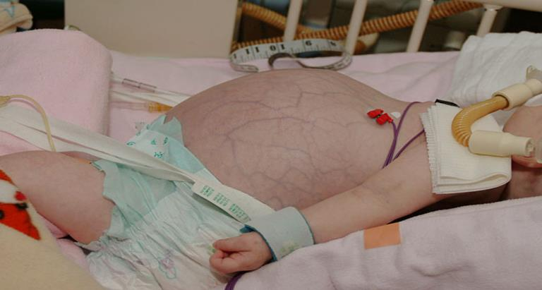
Patient with enlarging abdominal mass
Copyright © 2019 by ASPHO

Slide 19
Diffuse Liver Hemangioma
Copyright © 2019 by ASPHO

Slide 20
Hypothyroidism
Diffuse liver hemangiomas are associated with hypothyroidism
Functionally active T₄/T₃ are degraded by type 3 deiodinase enzyme (D3)
Increased levels of D3 leading to accelerated degradation of T₄/T₃
Huang SA et al N Engl J Med 2000 Jul 20;343(3):185-9
Copyright © 2019 by ASPHO

Slide 21
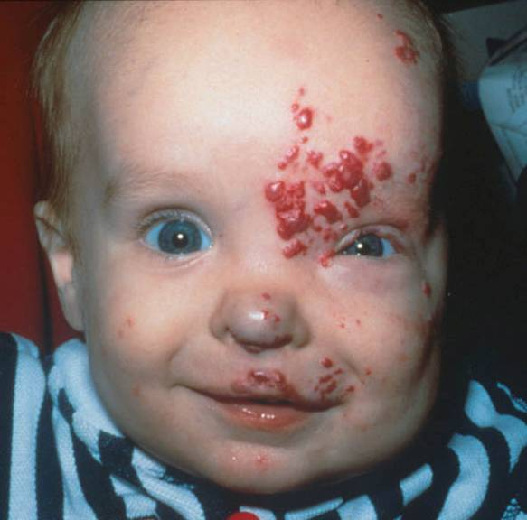
PHACE Syndrome
Posterior fossa malformations
Hemangiomas
Arterial anomalies
Cardiac anomalies
Eye anomalies
Sternal cleft or supraumbilical raphe syndrome
20% of infants with large cervicofacial hemangiomas will have one of associated anomalies of PHACE
Pacual-Castroviejo et al Neuroradiology 16, 1978
Frieden et al Arch Dermatol 132:307 311,1996
Copyright © 2019 by ASPHO

Slide 22
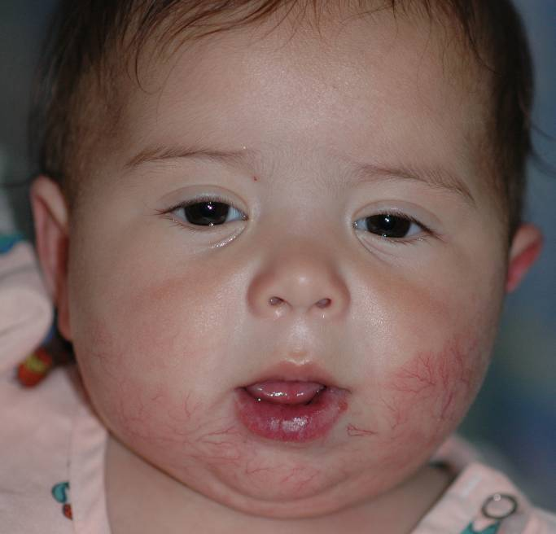
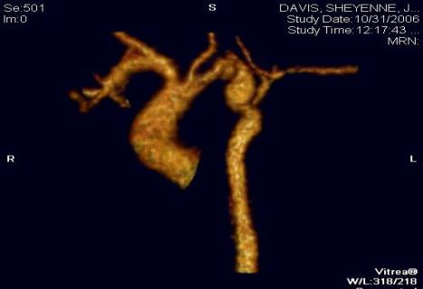
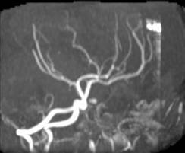
PHACE
Syndrome

Slide 23
Pelvis/Lumbar Syndrome
Segmental hemangioma
Abnormal arterial vessels
Neurological and/or genitourinary defects
Renal anomalies
Bony sacral anomalies
Leptomeningocele
Imperforate anus
Copyright © 2019 by ASPHO

Slide 24
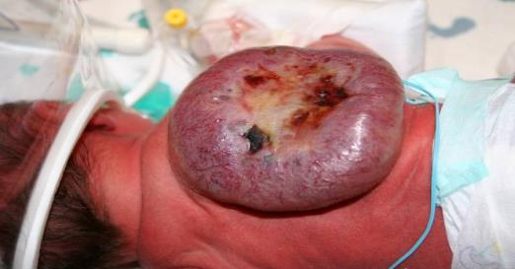
Variations on the theme Congenital Hemangioma
RICH-Rapidly involuting congenital hemangioma
NICH-Non-involuting congenital hemangioma
PICH-Partially-involuting congenital hemangioma
Congenital
Behave differently than infantile hemangioma
RICH and NICH overlap in appearance, location, size, equal sex ratio, radiological, and histological features
Glut1 negative, GNAQ somatic mutation
Transient consumptive coagulopathy
Copyright © 2019 by ASPHO

Slide 25
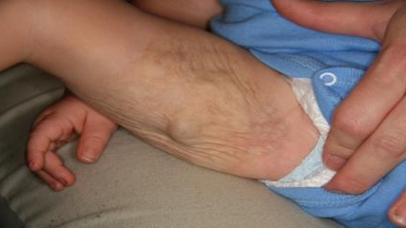
Rapidly Involuting Congenital Hemangioma (RICH)
Birth
1 Month
1 Year
Copyright © 2019 by ASPHO

Slide 26
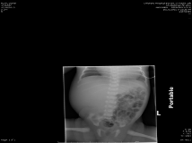
Hepatic RICH: Spontaneous Involution
Birth
8 Weeks
Copyright © 2019 by ASPHO

Slide 27
Focal Liver Lesion- Liver Congenital hemangioma
Copyright © 2019 by ASPHO

Slide 28
Management and Treatment
Copyright © 2019 by ASPHO

Slide 29
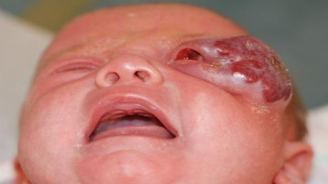
Immediate Treatment
Risk to Vital Structures
Airway/Obstruction
Intestines/Bleeding
Diffuse liver/Hypothyroidism, Compartment Syndrome
Eye/Vision
Copyright © 2019 by ASPHO

Slide 30
Other Anatomical Sites to Consider
Lip: Ulceration, Risk to Nutrition
Nose: Disfigurement, obstruction
Segmental Hemangioma/Ulceration: Associated anomalies
Breast: Disfigurement
Anogenital area: Ulceration, associated anomalies
Copyright © 2019 by ASPHO

Slide 31
Propranolol-First Line Treatment
Leaute-labreze et al, 2008, NEJM (358:2649-51)
Copyright © 2019 by ASPHO

Slide 32
FDA approved March 2014
Copyright © 2019 by ASPHO

Slide 33
Propranolol
Non - selective β-blocker
Mechanism of Action unknown
Proposed mechanism of action:
Vasoconstriction
Decreased angiogenesis by decreasing expression of VEGF and FGF
Endothelial apoptosis
Copyright © 2019 by ASPHO

Slide 34
Side effect
Common
Sleep disturbances (nightmares, irritability)
GI (constipation, diarrhea)
Acrocyanosis
Pulmonary issues
Uncommon
Symptomatic hypoglycemia
AV Block
Symptomatic decreased BP
Copyright © 2019 by ASPHO

Slide 35
Contraindications
Caution in neonates 0-4 weeks
Drug interactions (Also consider maternal drugs if breast feeding)
Reactive Airway Disease
AV Block
Hypoglycemia
Raynaud's
Hypersensitivity
Copyright © 2019 by ASPHO

Slide 36
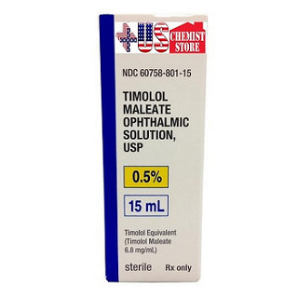
Topical Medication
Steroid
Timolol 0.25, 0.5 % Gel
-usually 0.5 % 1 drop BID
-Beware: Eye, Ulceration, Premature infants
New prospective trial: Efficacy, Safety and Pharmacokinetics of Topical Timolol in Infants with Infantile Hemangiomas
Propranolol not fully investigated
Copyright © 2019 by ASPHO

Slide 37
Other Medications
Selective Beta Blockers: Atenolol, Nadolol
Sirolimus
Combination Therapy
Copyright © 2019 by ASPHO

Slide 38
Rare Vascular Tumors
Classification of vascular tumors can be very difficult
Uncommon tumors
Clinical behavior varies
Morphologic appearance varies
Difficulty distinguishing benign vs. malignant lesions
Pediatric tumors are not independently stratified
Copyright © 2019 by ASPHO

Slide 39
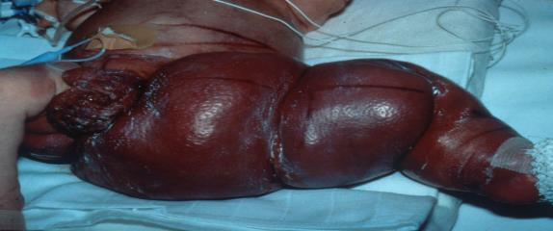
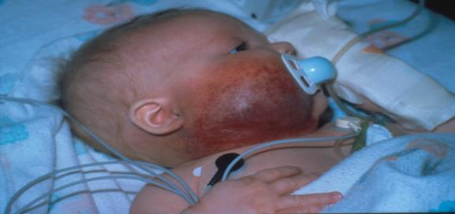
Kaposiform Hemangioendotheliomas and Tufted Angiomas*
Present at birth, also appear postnatally
Affect both sexes equally
Usually unifocal typically involving extremities, trunk, retroperitoneum, and head and neck, involving superficial and deep soft tissue
Overlying skin is deep red-purple in color, tense, and shiny
Kasabach-Merritt phenomenon: profound thrombocytopenia, hypofibrinogenemia with slightly high D-dimer (Coagulopathy)
Copyright © 2019 by ASPHO

Slide 40
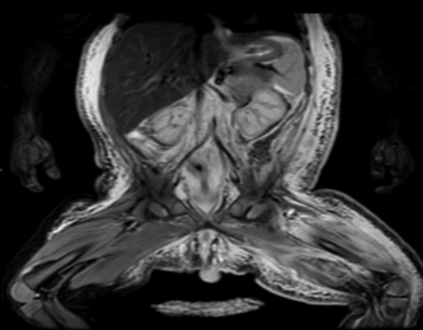
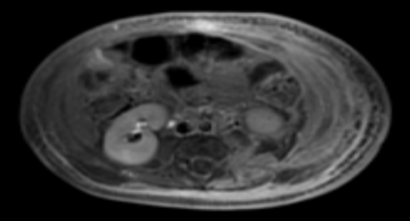
Kaposiform Hemangioendothelioma
General features
Tends to involve the trunk
Involvement of the skin, subcutaneous fat, and muscle is typical (edema like)
Majority are infiltrative with poorly defined borders
Generally hyperintense on T2 sequence with diffuse enhancement
Copyright © 2019 by ASPHO

Slide 41
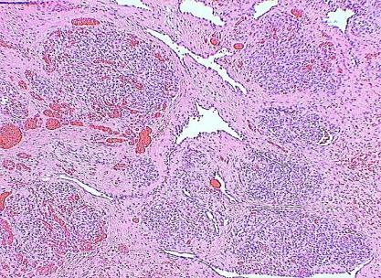
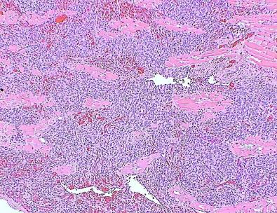
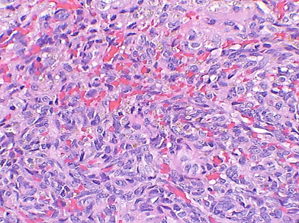
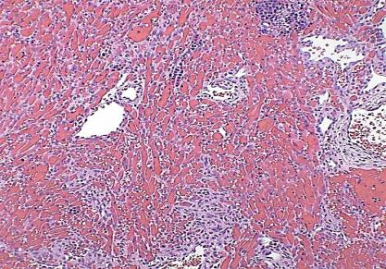
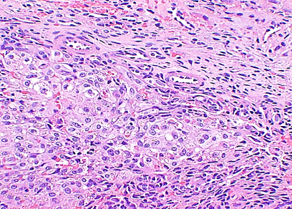
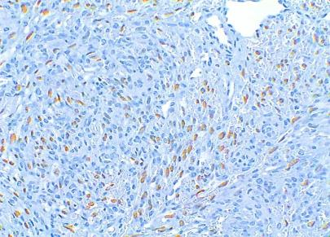
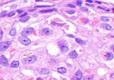
Kaposiform Hemangioendothelioma
Lobules
Coalescing Nodules
Spindle Cells
Vascular Pattern
Epithelioid
Prox-1
Copyright © 2019 by ASPHO
Notes:
Low power demonstrates a lesion composed of tightly packed spindle cells with slit-like vascular channels within and surrounding the lesion. The nodules are surrounded by fibrotic stroma. 2nd picture, the nodules coalesce and involve multiple planes.3rd picture High power of the spindle cells intermixed with extravasated RBCs, hemosidderin, and insert shows platelet microthrombi. 4th picture. Another pattern of KHE is the vascular type composed of small back to back dilated lymphatic channels engorged with RBCs. From our institutes experience this pattern of KHE is often seen in newborns with KHE and tend to have a relatively high MIB-1 index when compared to the spindled solid areas. 5th picture. KHE can have foci of epithelioid areas, 6th PROX-1 positivity is found is scattered spindle cells, epithelioid cells, and vascular channels.
Differences: coalescing nodules, platelet microthrombi, spindle cells around lymphatic channels and endothelial lining cells have lympthatic phenotype (+ for prox-1 (PG is not), D240)
PROX-1 (prospero homeobox 1) assigns endothelial cells to a lymphatic fate. It is more sensitive than D240( a monoclonal ab to Mr 40000 0-linked sialoglycoprotein)

Slide 42
Treatment
No prospective trials
Steroids
Vincristine
Interferon
Cytoxan
VAC
Amicar
Propanolol
Sirolimus
FDA study: Vcr vs Sirolimus for the Treatment of High Risk KHE
Copyright © 2019 by ASPHO

Slide 43
Sirolimus and Vascular Anomalies
Over 20 articles in Pubmed
Most retrospective
Other ongoing (Clinical Trial.gov)
Lymphatic Anomalies
KHE/TA
KLA
CLVA/KT
PTEN
Venous Malformations
BRBNS
FAVA
?AVM
?“lymphangiectasis”/CCLA
Copyright © 2019 by ASPHO

Slide 44
Side Effects
Immunosuppression
Mouth sores
Headache
Lymphedema
GI: nausea, diarrhea, constipation
Anemia
Increase in Lipids
Rare: thrombosis, capillary leak, pneumonitis, male infertility
Copyright © 2019 by ASPHO

Slide 45
Length of Treatment
Average time to effect
-Hematologic response in KHE 3 weeks
-Generally by 3 months
Length of treatment 2 years
Can wean off
Majority will reoccur
Will respond again
May not need as high of a dose
Copyright © 2019 by ASPHO

Slide 46
Multifocal Lymphangioendotheliomatosis and thrombocytopenia (MLT)
Skin lesions noted at birth but may be very faint
Thrombocytopenia but not as severe at KHE
Involvement: GI, skin, lungs and any other organ
Can cause significant GI bleeding and pulmonary hemorrhage
Treatment: steroids, sirolimus, thalidomide, Avastin
LYV-1 positive
Copyright © 2019 by ASPHO

Slide 47
Malignant Vascular Tumors
Epithelioid Hemangioendothelioma
-peak incidence 4th and 5th decade but can occur in younger patients
-varied course
-effusions, pain, tumor size greater than 3cm or high mitotic rate is high risk
-WWTR1-CAMTA 1 gene fusion
-Less commonly YAP1-TFE3
-sites: liver, bone, soft tissue, skin
-Treatment: Observation, surgery, targeted therapy, chemotherapy
Copyright © 2019 by ASPHO

Slide 48
Malignant Tumors
Angiosarcoma
-Rare 2% of sarcomas
-aggressive
-Risk factors: Radiation exposure, vinyl chloride exposure, chronic lymphedema (Stewart- Treves Syndrome)
-20% can be Glut-1 positive
-reports of transformation of hemangiomas of the liver and lymphatic anomalies
-Treatment: chemotherapy, surgery , radiation, targeted therapy
Copyright © 2019 by ASPHO

Slide 49
Vascular Malformations
Copyright © 2019 by ASPHO

Slide 50
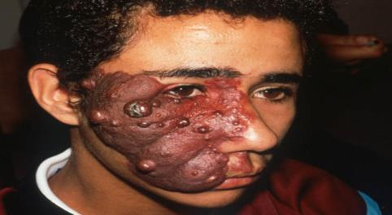
Vascular Malformations
Copyright © 2019 by ASPHO

Slide 51
Capillary Malformations
Localized or extensive, occur anywhere on the body
Become darker with age and are prone to nodular fibrovascular overgrowth
May be a red flag for underlying structural abnormality
Composed of dilated capillary-to-venular-sized vessels in the superficial dermis
Sturge-Weber syndrome
Treatment:pulsed-dye laser
Copyright © 2019 by ASPHO

Slide 52
Sturge-Weber Syndrome
Facial CM with involvement of underlying meningeal structures
Must evaluate for glaucoma
Variable degrees of seizure activity, mental retardation
Copyright © 2019 by ASPHO

Slide 53
Capillary Malformations Sturge-Weber Syndrome
Aspirin (Bay 2011)
Survey: Reduced seizures and stroke-like episodes
Ongoing: Presymptomatic treatment with aspirin
mTor Inhibitors (Shirazi 2007, NEJM 2013)
AKT upregulated in biopsies from patients with Sturge-Weber syndrome
GNAQ mutations
Copyright © 2019 by ASPHO

Slide 54
Venous Malformations
Present at birth but not always evident
Bluish, soft and compressible
Localized or extensive
Most frequently in skin and subcutaneous tissue but can involve muscle, viscera and brain
Composed of thin-walled, dilated, sponge-like abnormal channels
Pain, COAGULOPATHY
LIC: increased D-dimer, low fibrinogen, can have low/normal platelets
Syndromes: BRBN
TIE-2 mutation
Copyright © 2019 by ASPHO

Slide 55
Abnormal endothelium lining (structural and functional)
Abnormal size and direction of the vessels and blood flow
Localized intravascular coagulopathy (LIC)
Copyright © 2019 by ASPHO

Slide 56
What We Know
Vascular anomalies are at an increased risk for hematological complications (bleeding and clotting)
Increased risk of complications after surgical or invasive radiological procedures
The pathogenesis is poorly understood. The incidence is not well-documented
The coagulopathy is often mistakenly labeled thus perpetuating misdiagnosis and mistreatments
Copyright © 2019 by ASPHO

Slide 57
High Risk Diagnosis
Extensive or multifocal venous malformations (VM)
Combined slow-flow lesions with VM (LVM, CLVM)
CLOVES
Obtain laboratory investigation:
- D-dimer
- PT / aPTT
- Fibrinogen
- CBC with smear
Low Risk
High Risk
- Normal PT / aPTT &
- Normal fibrinogen &
- No venous ectasia &
- Normal platelet count &
- D-dimer normal or <5x ULN &
- Negative personal medical history of thrombosis &
- No family history of thrombosis in 1st degree family members
- Low fibrinogen OR
- Venous ectasia OR
- D-dimer >5x normal OR
- Thrombocytopenia (without other explanation) OR
- Positive personal or family history of thrombosis
- LMWH likely not indicated
- Encourage early ambulation
- Institutional standard care with mechanical thromboprophylaxis
- Two weeks prior to procedure, start LMWH 0.5mg /kg SC BID for 1 week, recheck labs.
- If abnormality still present, increase to 1 mg/kg SC BID, recheck labs in pre-op.
- Post-procedure, continue pre-procedure dose for 2 weeks or baseline ambulation, whichever is longer
LVM: lymphatic venous malformation, CLVM: capillary lymphatic venous malformation = Klippel-Trenaunay syndrome, CLOVES: congenital lipomatous with vascular anomalies, epidermal nevus and spinal/skeletal/scoliosis
Copyright © 2019 by ASPHO

Slide 58
Additional Suggestions -> High Risk
Ectasia:
- Enlarged veins with slow flow and concerning risk for thromboembolism
on imaging by radiologist or on physical examination by vascular anomalies
expert.
- Appropriate vascular imaging to rule out ectasia is highly recommended in
patients with overgrowth syndromes and vascular anomalies (e.g. KTS,
CLOVES).
- If venous ectasia has been corrected (endovenous laser or device) or
removed, risk of thromboembolism is back to baseline. If caval filter is in place,
we recommend peri-procedural anticoagulation until filter is removed.
Compression stockings:
- Graduated compression stockings are highly encouraged.
Copyright © 2019 by ASPHO

Slide 59
Lymphatic Malformation
Copyright © 2019 by ASPHO

Slide 60
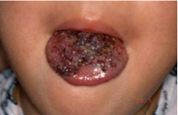
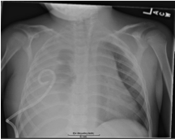
Classification of Lymphatic Anomalies
Tumors – progressive, infiltrative, spindled cells
Malformations – cysts that may swell and empty of lymphatic fluid, swell suddenly with infection or hemorrhage
Dysfunctional channel disorders – central conducting channels or peripheral channels in one region
All may worsen with inflammation or trauma and predispose to bacterial infection
Avoid rib biopsies, which may lead to refractory pleural effusions
Copyright © 2019 by ASPHO

Slide 61
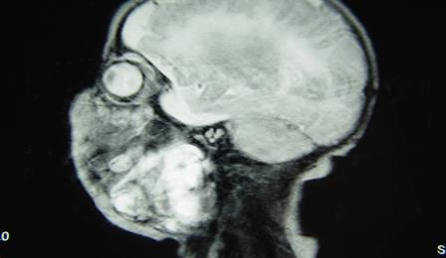
Common Malformations
Usually localized
Can cause issues depending on where the lesions are located
Can be macro or microcystic
More common in the head and neck
Copyright © 2019 by ASPHO

Slide 62
Generalized Lymphatic Anomaly (GLA)
Can present at any age
Multiple areas of involvement: lungs, bone, GI tract, skin
Bony lesions do NOT destroy the cortex
Effusions can occur with infection, trauma or puberty
Copyright © 2019 by ASPHO

Slide 63
Gorham Stout Disease (GSD)
Hallmark is progressive bony disease with destruction through the cortex
Can have other areas of lymphatic disease: soft tissue, spleen, lung, GI tract
Copyright © 2019 by ASPHO

Slide 64
Kaposiform Lymphangiomatosis (KLA)
New entity
Proliferative component
Areas of spindle cells
Hemorrhagic effusion
Coagulopathy
Multifocal
Lungs commonly involved but also can present in the soft tissue and GI tract
Poor prognosis
Copyright © 2019 by ASPHO

Slide 65
MRL Imaging/Central Collecting Lymphatic Anomalies
Leak
Leak
Dilated tortuous
Thoracic Duct
Pleural effusion
Copyright © 2019 by ASPHO

Slide 66
CLOVES Syndrome
Congenital Lipomatous Overgrowth
Vascular Anomalies
Epidermal Anomalies
Skeletal Anomalies
Caused by a somatic mutation arising during early embryonic development
PIK3CA mutations
Increased incidence of Wilms Tumor
Copyright © 2019 by ASPHO

Slide 67
Medical Treatment in the Literature
There is NO standard of care
Steroids
Interferon
Bisphosphonates
Vincristine
Cytoxan
Sclerotherapy
Thalidomide
Radiation
Surgery
Marismastat
LMWH
Copyright © 2019 by ASPHO
Notes:
Mostly in retrospective case reports, NO prospective randomized trials
There is NO standard of Care: Surgery management also plays a large role.
Steroids
Interferon
Vincristine
Cytoxan
VAC
VACM
Cytoxan/VCR + interferon
Anti-platelet agents + chemo --mostly KHE
Anti-fibrinolytic agents + chemo --mostly KHE
Sclerotherapy with OK-432, ethanol, sodium tetradecyl sulfate or doxycycline
Anti-angiogenic agents?

Slide 68
Genotype/Phenotype Correlation
Gene | Diagnosis
PIK3CA | VM, CLOVES, FAVA, FIL, KTS, LM, MCM
AKT | PROTEUS
PTEN | PHOS
TIE2 | VM, BRBNS, CUTANEOMUCOSAL VM
MAP2K1 | EXTRA CRANIAL AVM
GNAQ | CH, CM
GNA11 | CH,CM
KHE | GNA14
CCM | KRIT, MAOALVERNIN, PPCD10
MAP31C3 | PYOGENIC GRANULOMA
BRAF,NRAS | PYOGENIC GRANULOMA
NRAS | KLA
RASA | PWS, CCLA
Copyright © 2019 by ASPHO

Slide 69
Future directions
Parallels between vascular anomalies and solid tumor oncology pre-CCG/POG
ASPHO Special Interest Group
Collaborative projects and registries
First multi-center trial of sirolimus completed published in Pediatrics
Second trial funded accruing patients
Other Phase I/II studies (AKT inhibitor, PIK3CA inhibitors, MEK inhibitors)
VA Consortium: CaNVAs
Copyright © 2019 by ASPHO

Slide 70
Thank you! Future Vascular Anomalist Sign up NOW!
Copyright © 2019 by ASPHO

Slide 71
Appendix
Copyright © 2019 by ASPHO

Slide 72
Propranolol Treatment
Inpatient: < 2months or medical issues
Echo/EKG only if clinically necessary and a good cardiopulmonary exam can not be done
Baseline labs only if medical indication
Glucose 2hrs after each dose only if medical indication
Vital signs at 1 and 2 hours after dose
Start .5 mg/kg/day divided every 8-12 hours
Increase dose every day by 0.5 – 1 mg/kg/day
Increase to 1 - 3 mg/kg/day
Outpatient: > 2 months
EKG only if clinically necessary and a good cardiopulmonary exam can not be done
Observe for 2 hours
Vital Signs at 1 and 2 hours after dose
Start 0.5mg/kg/day divided every 8-12 hours increase dose every week by 0.5 to 1 mg/kg/day
NOTE:
-Airway lesions usually require 3 mg/kg/day.
-Ulcerated hemangiomas may need a slower dose escalation.
-Q12 hour dosing may be better as a BID dosing schedule.
- Infants less than 6 weeks should be woken every 4 hours to feed . Infants 6 weeks to 4 months should be woken every 6 hours . Older than 4 months 8 hours.
(Suggested supportive guidelines)
Copyright © 2019 by ASPHO

Slide 73
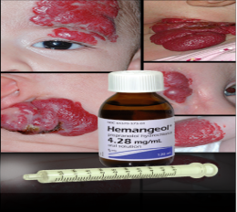
Preparations
Generic propranolol hydrochloride oral solution
Commercially available in 2 concentrations: 4 mg/mL and 8 mg/mL
Consider taste
In 2014 the FDA approved Hemangeol
Available in a single concentration of 4.28 mg/mL
Alcohol, paraben, and sugar free
Consider taste
Copyright © 2019 by ASPHO

Slide 74
Sirolimus Dosing
0.8 – 1.0 mg/m2/dose
BID/QD
Neonate and Infant dosing differs
Troughs 8-13 ng/ml for complicated patients
Troughs 4-8 ng/ml for less complicated patients
Lowest dose that gives the patient the best effect. Effect needs to be defined
Copyright © 2019 by ASPHO

Slide 75
Dosing for neonates and infants
10 – 15 ng/ml
6 – 10 ng/ml
Age group | Dose (mg/m² every 12h)
0–1 months | 0.4
1–2 months | 0.5
2–3 months | 0.6
3–4 months | 0.7
4–6 months | 0.9
6–9 months | 1.1
9–12 months | 1.3
12–24 months | 1.6
Age group | Dose (mg/m² every 12h)
0–1 months | 0.28
1–2 months | 0.34
2–3 months | 0.4
3–4 months | 0.46
4–6 months | 0.58
6–9 months | 0.7
9–12 months | 0.82
12–24 months | 1
Copyright © 2019 by ASPHO

